Slide 1
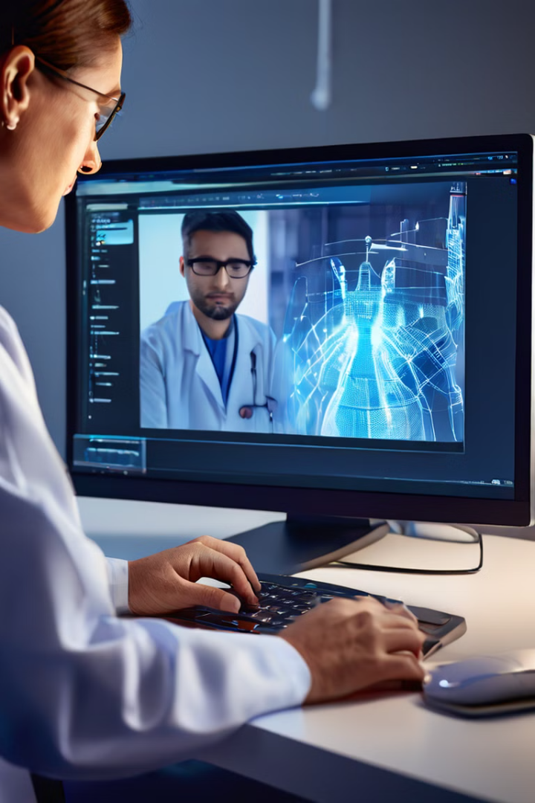
Transformative Innovations in Medical Diagnostics Through Artificial Intelligence
AI is revolutionizing medical imaging, using deep learning to analyze images with unprecedented accuracy. This is transforming diagnosis and patient care.

Slide 2
CNNs in Medical Imaging
Core Technology
Training
Advantages
CNNs learn hierarchical image representations, identifying key patterns for diagnosis.
CNNs are trained on annotated medical images to distinguish normal and abnormal patterns.
High accuracy and efficient processing of large image volumes.

Slide 3
Training AI Models
Data Acquisition
Data Preprocessing
Model Training
Validation
Gather a large, diverse dataset of annotated medical images covering normal and abnormal conditions.
Use a CNN to learn associations between images and labels, extracting key diagnostic patterns.
Evaluate model performance on a validation set to prevent overfitting and tune hyperparameters.
Preprocess and standardize the images, using techniques like resizing, cropping, and data augmentation.

Slide 4
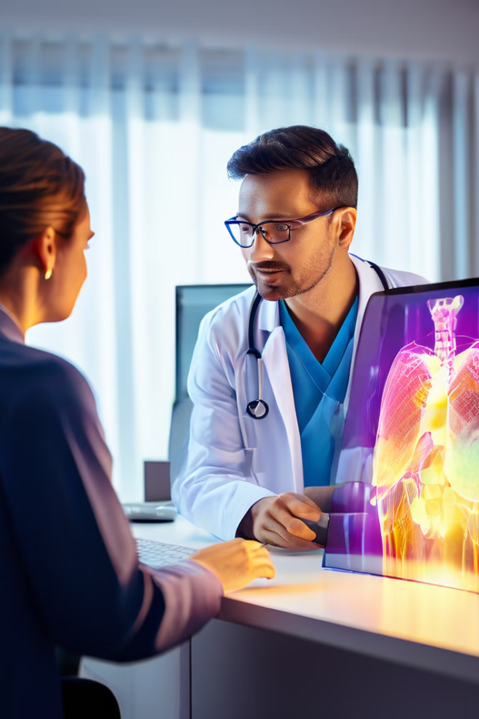
AI in Medical Specialties
1
Radiology
Identifying abnormalities in X-rays, MRIs, and CT scans.
2
Oncology
Detecting and staging cancer from imaging data.
3
Cardiology
Analyzing ECGs and echocardiograms for heart conditions.
4
Neurology
Diagnosing neurological disorders from MRI scans.

Slide 5

AI Benefits in Diagnostics
1
Enhanced Accuracy
AI can detect subtle abnormalities better than humans, improving diagnosis.
2
Faster Analysis
AI systems analyze images much faster, enabling quicker diagnosis.
3
Expanded Access
AI can provide diagnostic support in areas with limited specialist care.
4
Workload Reduction
AI assists radiologists by highlighting areas of concern, allowing them to focus on complex cases.

Slide 6


Ethical Challenges
1
Biased Data
2
Privacy & Security
Ensure training data is diverse and representative to avoid perpetuating inequalities.
Protect sensitive patient data with robust security measures.
3
Transparency
4
Overreliance
Explain how AI models reach conclusions to build trust and accountability.
Maintain human oversight and use AI as a tool to enhance expertise, not replace it.

Slide 7

Future Directions
Advancements in Deep Learning
Multimodal Integration
AI-Assisted Intervention
Combining medical images, records, and genetics for personalized diagnoses.
AI-guided surgery and robotics to enhance accuracy and precision.
Developing more accurate deep learning algorithms to identify subtle abnormalities.

Slide 8

Healthcare Impact
1
Better Outcomes
2
Enhanced Capabilities
Improve patient care through earlier detection and personalized treatment.
Empower healthcare providers to make more informed decisions.
3
Cost Reduction
4
Societal Impact
Increase efficiency and reduce unnecessary tests, leading to more affordable care.
Transform healthcare systems to be more equitable and accessible.

Slide 9

A New Era of Medical Imaging
AI-powered diagnostic systems hold immense promise for improving patient care and advancing medical practice. As the technology continues to evolve, we can expect more precise, efficient, and accessible healthcare in the future.

